Slide 1
The Limits to Growth: Sustainability and the Circular Economy
Lecture 5: Lifecycle Assessment (LCA)
Prof. Dr. Benjamin Leiding
M.Sc. Anant Sujatanagarjuna

Slide 2
License
This work is licensed under a Creative Commons Attribution-ShareAlike 4.0 International License. To view a copy of this license, please refer to https://creativecommons.org/licenses/by-sa/4.0/ .
Updated versions of these slides will be available in our Github repository.

Slide 3
Exercise E03 – Favorite Fruit/Vegetable

Slide 4
Introduction

Slide 5

LCA – Motivation

Slide 6
LCA – Motivation
Battery Electric Vehicles (EV)
Or
Internal Combustion Engine Vehicles

Slide 7
EV Break-Even Point?
0 – 50.000km
50.000 – 100.000km
100.000 – 150.000km
150.000 – 200.000km
After 200.000km
What is the break-even point (in km) after which an EV would have caused fewer emissions than an Internal Combustion Engine (ICE?)

Slide 8
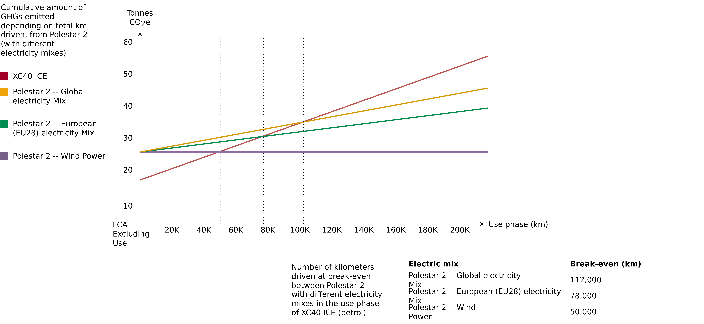
Life Cycle Assessment – Polestar 2
Polestar (2020) – Life Cycle Assessment – Carbon Footprint of Polestar 2.

Slide 9
Lifecycle Assessment (LCA)

Slide 10
Lifecycle Assessment (LCA)
Definition
“LCA addresses the environmental aspects and potential environmental impacts (e.g. use of resources and environmental consequences of releases) throughout a product’s lifecycle from raw material acquisition through production, use, end-of-life treatment, recycling and final disposal (i.e., cradle-to-grave).” -- ISO 14040
ISO 14040 Environmental management — Life cycle assessment — Principles and framework, International standards organisation (https://www.iso.org/standard/37456.html)

Slide 11
Lifecycle Assessment (LCA)
ISO 14040 & ISO 14044
The ISO 14040/14044 (ISO14040, 2006) (ISO14044, 2006) together provide a loose methodology for conducting LCA studies.
ISO 14040 defines the principles and framework of the standard
ISO 14044 provides requirements and guidelines for LCA practitioners.
Their scope is very broad, hence requiring LCA practitioners to further refine the methodology for their specific needs.
More info on points, percentages, etc. follow on the next slides (Examination)
ISO 14040 Environmental management — Life cycle assessment — Principles and framework, International standards organisation (https://www.iso.org/standard/37456.html)
ISO 14044 Environmental management — Life cycle assessment — Requirements and guidelines, International standards organisation (https://www.iso.org/standard/38498.html)

Slide 12
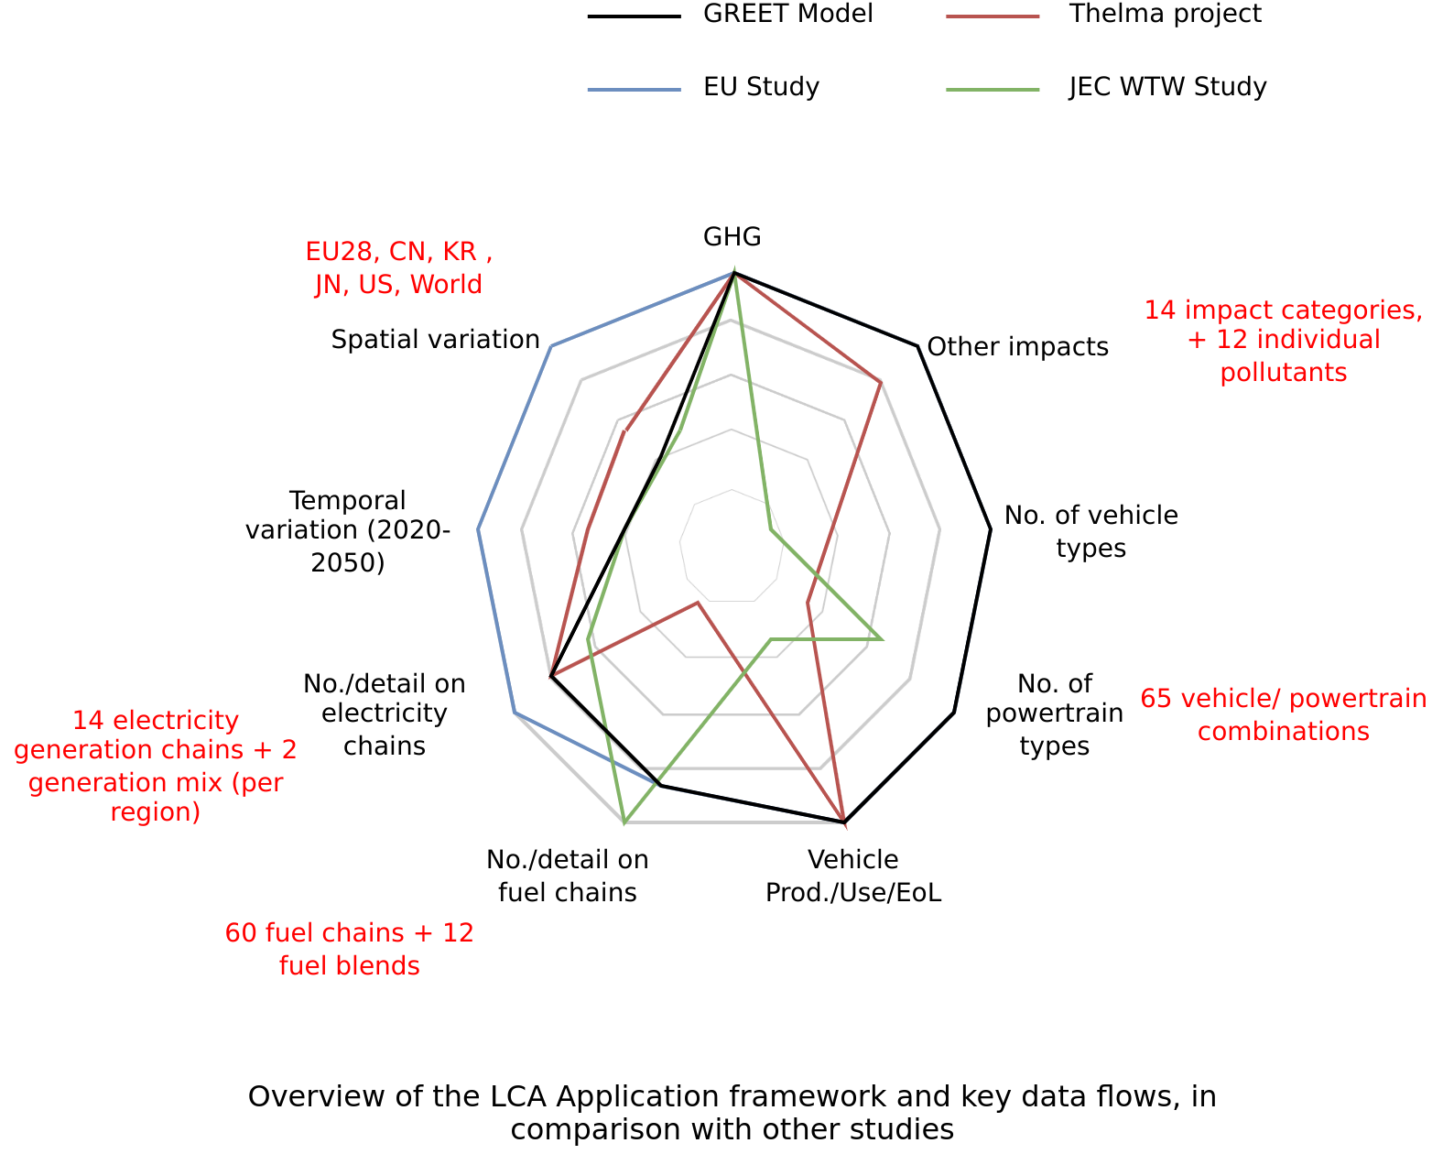
Running Case Study
2020 EU Commission Report
“Determining the environmental impacts of conventional and alternatively fuelled vehicles through LCA”
Prepared by Ricardo Energy and Environment
Generally follows the ISO 14040 and ISO 14044 standards.
More info on points, percentages, etc. follow on the next slides (Examination)
Image adapted from Determining the environmental impacts of conventional and alternatively fuelled vehicles through LCA, Ricardo Energy and Environment (Link)

Slide 13
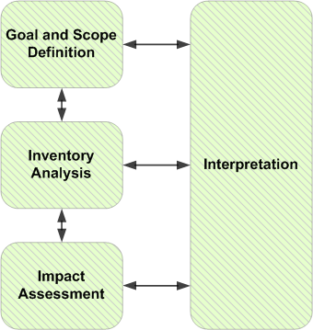
Four main phases of LCA
LCI
LCIA
Mr3641 – https://commons.wikimedia.org/wiki/File:PhasesOfLifeCycleAnalysis.png – CC BY-SA 4.0.

Slide 14
Goal and scope definition

Slide 15
Goal and Scope definition
Goal of an LCA study
ISO 14040 definition
The goal of an LCA states:
The intended application
The reasons for carrying out the study
The intended audience
Whether the results are intended to be used in comparitive assertions released publicly
2020 EU Study
Explores the environmental impact of a representative selection of road vehicle configurations in a holistic manner.
Aims to enhance the Commission's understanding of environmental impacts and of suitable methodologies to assess them in the mid- to long-term time frame (until 2050).
Targets an audience comprising primarily the European Commission and secondarily decision-makers in general.
ISO 14040 Environmental management — Life cycle assessment — Principles and framework, International standards organisation (https://www.iso.org/standard/37456.html)
Determining the environmental impacts of conventional and alternatively fuelled vehicles through LCA, Ricardo Energy and Environment (Link)

Slide 16
Goal and Scope definition
Scope of an LCA study
ISO 14040 standard
The scope of an LCA should describe:
The functional units of the system(s)
Reference Flows
The system boundary
LCIA methodology and types of impacts analysed
Limitations
Data quality requirements
...
quantified performance of a product system for use as a reference unit
measure of the outputs from processes in a given product system required to fulfil the function expressed by
the functional unit
ISO 14040 Environmental management — Life cycle assessment — Principles and framework, International standards organisation (https://www.iso.org/standard/37456.html)

Slide 17
Goal and Scope definition
Scope of an LCA study
ISO 14040 definition
The scope of an LCA should describe:
The functional units of the system(s)
Reference Flows
The system boundary
LCIA methodology and types of impacts analysed
Limitations
Data quality requirements
…
2020 EU Study
Functional Units
Based on Vehicle size and utility
Body Type | Passenger Car | Van | Rigid Lorry | Artic Lorry | Urban bus | Coach
Default reference flow | Vehicle-km (vkm) | Vehicle-km (vkm) | Tonne-km (tkm) | Tonne-km (tkm) | Vehicle-km (vkm) | Vehicle-km (vkm)
ISO 14040 Environmental management — Life cycle assessment — Principles and framework, International standards organisation (https://www.iso.org/standard/37456.html)
Determining the environmental impacts of conventional and alternatively fuelled vehicles through LCA, Ricardo Energy and Environment (Link)

Slide 18
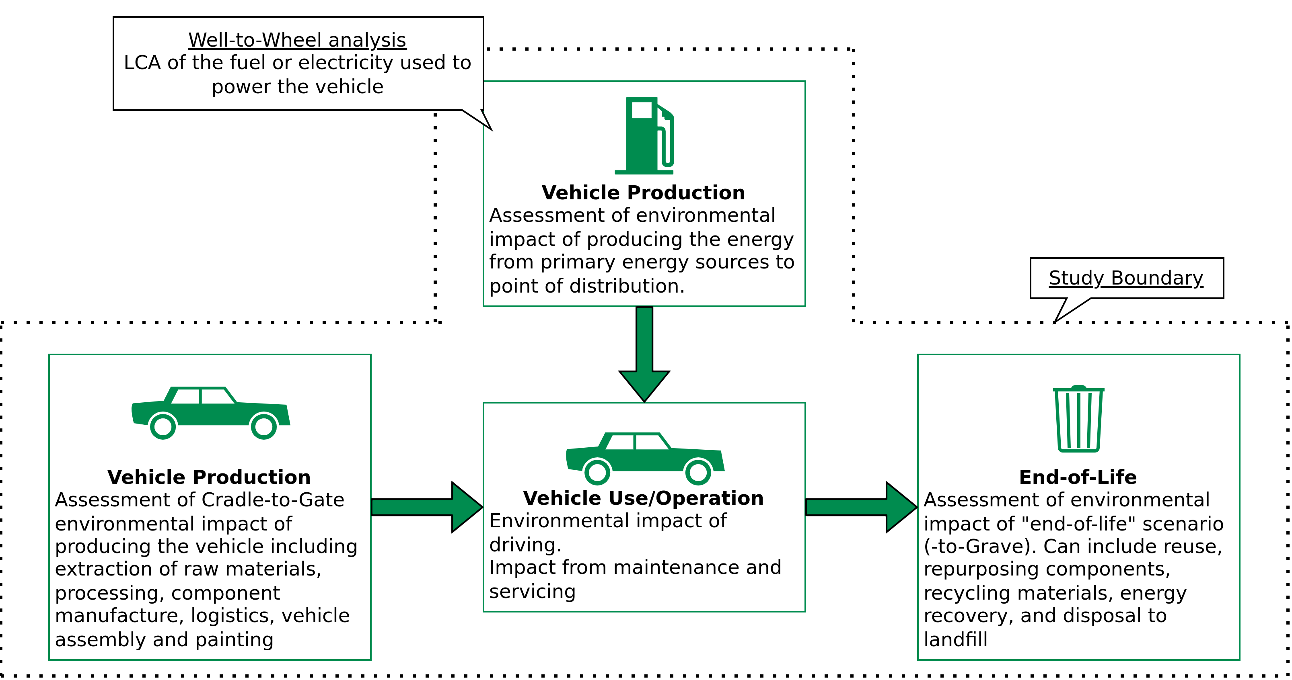
Goal and Scope definition
Scope of an LCA study
ISO 14040 definition
The scope of an LCA should describe:
The functional units of the system(s)
Reference Flows
The system boundary
LCIA methodology and types of impacts analysed
Limitations
Data quality requirements
...
2020 EU Study system boundary
ISO 14040 Environmental management — Life cycle assessment — Principles and framework, International standards organisation (https://www.iso.org/standard/37456.html)
Image recreated from Determining the environmental impacts of conventional and alternatively fuelled vehicles through LCA, Ricardo Energy and Environment (Link)

Slide 19
Goal and Scope definition
Quantitative definition of system boundaries – the Cut-off criteria
In general, all processes and flows that are attributable to the analysed system are to be included in the system boundaries.
However, not all of them are quantitatively “relevant”.
For less relevant ones, data of lower quality (estimates) can be used, limiting the effort for collecting high quality data.
Irrelevant ones, can be entirely “Cut-off”
ILCD Handbook – General guide for Life Cycle Assessment – Detailed Guidance (Link)

Slide 20
Goal and Scope definition
Quantitative definition of system boundaries – the Cut-off criteria
“Cut-off” refers to the omission of not relevant life cycle stages, activity types (e.g. investment goods, storage, …), specific processes and products and elementary flows from the system model.
Cut-offs are quantified in relation to the percentage of environmental impacts that is approximated to be excluded via the cut-off.
e.g., "95 %" relates to cutting off about 5 % of the total environmental impact (or of a selected impact category)
ILCD Handbook – General guide for Life Cycle Assessment – Detailed Guidance (Link)

Slide 21
Goal and Scope definition
Quantitative definition of system boundaries – the Cut-off criteria
“Cut-off” refers to the omission of not relevant life cycle stages, activity types (e.g. investment goods, storage, …), specific processes and products and elementary flows from the system model.
Cut-offs are quantified in relation to the percentage of environmental impacts that is approximated to be excluded via the cut-off.
e.g., "95 %" relates to cutting off about 5 % of the total environmental impact (or of a selected impact category)
BUT, this would require an approximation of 100% of the impact, because if we already knew what 100% impact is, we wouldn’t be doing the study anyway.
IMPORTANT: Cut-off should not be so big, or you can risk having incomplete data (meaning lower environmental impacts) and also overall uncertainity.
ILCD Handbook – General guide for Life Cycle Assessment – Detailed Guidance (Link)

Slide 22
2020 EU Study
Goal and Scope definition
Scope of an LCA study
ISO 14040 definition
The scope of an LCA should describe:
The functional units of the system(s)
Reference flows
The system boundary
LCIA methodology and types of impacts analysed
Limitations
Data quality requirements
...
Impact Category | Indicator and unit
Climate change | Greenhouse gas emissions GWP100 in CO2 eq (including carbon feedbacks)
Energy consumption | Cumulative energy demand in MJ: non-renewable (fossil and nuclear) and renewable
Acidification | Acidification potential in SO2 eq
Eutrophication | Eutrophication potential in PO4³⁻ eq
Photochemical ozone formation | Photochemical Ozone Creation Potential POCP in NMVOC eq
Ozone depletion | ODP in R11 eq
Ionising radiation | Ionising radiation potentials in U235 eq
Particulate matter | Particulate matter formation in PM2.5 eq
Human toxicity, cancer and non-cancer | Comparative Toxic Unit for Human Health in CTUh
Ecotoxicity, freshwater | Comparative Toxic Unit for ecosystems in CTUe
Resource depletion – minerals and metals | ADP ultimate reserves in Sb eq
Resource depletion – fossil energy carriers | ADP fossil in MJ
Land use | Land occupation in m² * a
Water scarcity | Scarcity-adjusted water use in m³
ISO 14040 Environmental management — Life cycle assessment — Principles and framework, International standards organisation (https://www.iso.org/standard/37456.html)
Table recreated from Determining the environmental impacts of conventional and alternatively fuelled vehicles through LCA, Ricardo Energy and Environment (Link)

Slide 23
Lifecycle Inventory Analysis (LCI)
Definitions
ISO 14040 definition
LCI is the phase of lifecycle assessment involving the compilation and quantification of inputs and outputs for a product throughout it’s lifecycle.
ISO 14040 Environmental management — Life cycle assessment — Principles and framework, International standards organisation (https://www.iso.org/standard/37456.html)

Slide 24
Lifecycle Inventory Analysis (LCI)
Definitions
ISO 14040 definition
LCI is the phase of lifecycle assessment involving the compilation and quantification of inputs and outputs for a product throughout it’s lifecycle.
Inputs and outputs are product, material or energy flows that enter or leave a unit process.
ISO 14040 Environmental management — Life cycle assessment — Principles and framework, International standards organisation (https://www.iso.org/standard/37456.html)

Slide 25
Lifecycle Inventory Analysis (LCI)
Definitions
ISO 14040 definition
LCI is the phase of lifecycle assessment involving the compilation and quantification of inputs and outputs for a product throughout it’s lifecycle.
Inputs and outputs are product, material or energy flows that enter or leave a unit process.
A Unit Process is the smallest element considered in the life-cycle inventory analyis for which input and output data are quantified.
ISO 14040 Environmental management — Life cycle assessment — Principles and framework, International standards organisation (https://www.iso.org/standard/37456.html)

Slide 26
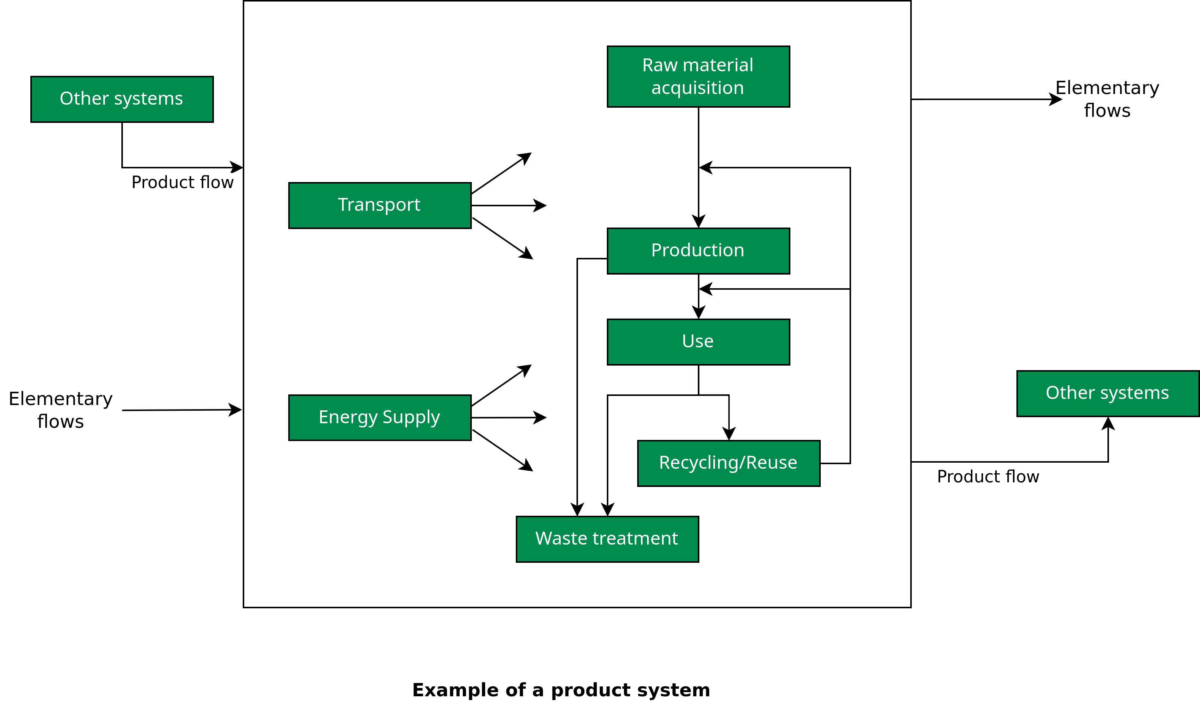
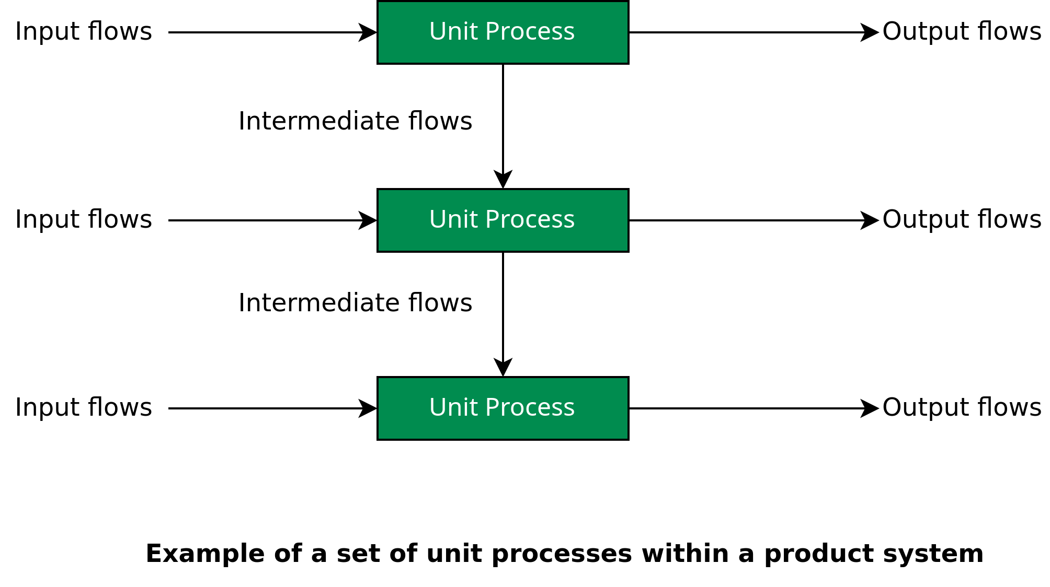
Lifecycle Inventory Analysis (LCI)
Images recreated from ISO 14040 Environmental management — Life cycle assessment — Principles and framework, International standards organisation (https://www.iso.org/standard/37456.html)

Slide 27
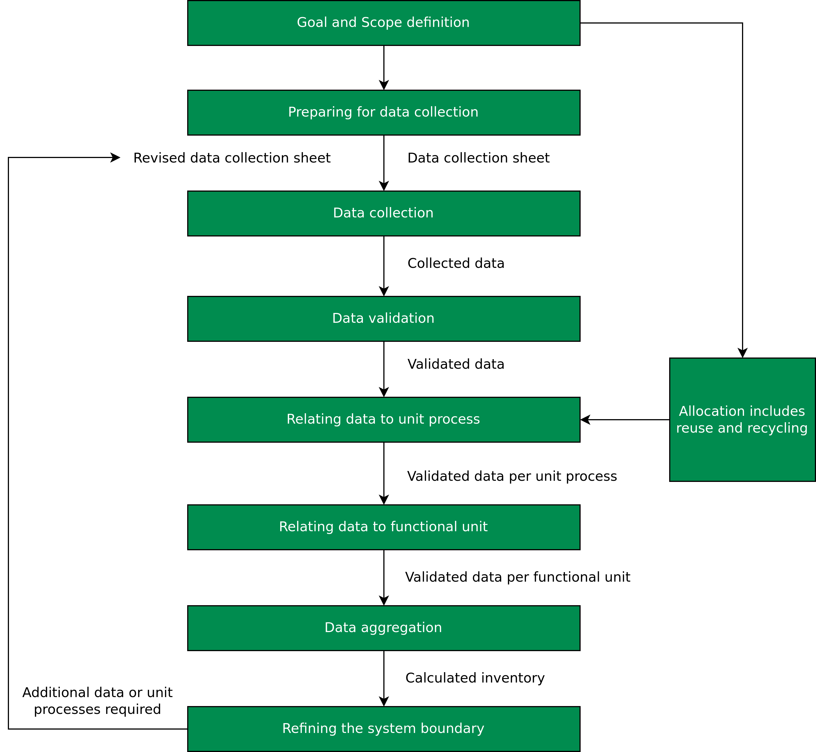
Lifecycle Inventory Analysis (LCI)
Overview
Image recreated from ISO 14040 Environmental management — Life cycle assessment — Principles and framework, International standards organisation (https://www.iso.org/standard/37456.html)

Slide 28
Lifecycle Inventory Analysis (LCI)
Preparing for data collection
Completed by: | Date of completion:
Unit process identification: | Reporting location:
Time period: Year | Starting month: | Ending month:
Description of unit process:
Material inputs | Units | Quantity | Description of sampling procedures | Origin
... | ... | ... | ... | ...
Water consumption | Units | Quantity
... | ... | ... | ... | ...
Energy Inputs | Units | Quantity | Description of sampling procedures | Origin
... | ... | ... | ... | ...
Material outputs | Units | Quantity | Description of sampling procedures | Destination
... | ... | ... | ... | ...
Image and table recreated from ISO 14040 Environmental management — Life cycle assessment — Principles and framework, International standards organisation (https://www.iso.org/standard/37456.html)

Slide 29
Lifecycle Inventory Analysis (LCI)
Data collection and validation
Data must be validated to confirm and provide evidence for data quality requirements, both during and after the data collection process.
This can also involve establishing mass and energy balances.
Obvious anomalies can necessitate collecting alternative data.
ISO 14040 Environmental management — Life cycle assessment — Principles and framework, International standards organisation (https://www.iso.org/standard/37456.html)

Slide 30
Lifecycle Inventory Analysis (LCI)
Relating data to unit process and functional unit
Based on the flow chart and the flows between unit processes, the flows of all unit processes are related to the reference flow.
The calculation should result in all system input and output data being referenced to the functional unit.
Recall: the reference flow is a measure of the outputs from processes in a given product system required to fulfil the function expressed by the functional unit.
ISO 14040 Environmental management — Life cycle assessment — Principles and framework, International standards organisation (https://www.iso.org/standard/37456.html)

Slide 31
Lifecycle Inventory Analysis (LCI)
Relating data to unit process and functional unit
In the example of a truck, a specific transport scenario would be defined in the study that uses the data set for the specific truck used, ensuring again a clear identification and quantification.
E.g. the transport scenario “150 km overland transport of bulk sand transport at 90 % load factor” with the quantity and unit of e.g. 1 t*km and the data set “Truck bulk transport; Euro 0, 1, 2, 3, 4 transport mix; 22 t total weight, 17.3 t max payload”.
ILCD Handbook – General guide for Life Cycle Assessment – Detailed Guidance (Link)

Slide 32
Lifecycle Inventory Analysis (LCI)
Refining the system boundary
The initial system boundary is revised, in accordance with the cut-off criteria established before.
Further analysis may result in:
Exclusion of life cycle stages or unit processes if they lack significance
Exclusion of inputs or outputs
Inclusion of new unit processes, inputs and outputs that are shown to be more significant than estimated before.
ILCD Handbook – General guide for Life Cycle Assessment – Detailed Guidance (Link)

Slide 33
Lifecycle Impact Assessment (LCIA)
Definition
ISO 14040 definition
The phase of life cycle assessment aimed at understanding and evaluating the magnitude and significance of the potential environmental impacts for a product system throughout the life cycle of the product.
ISO 14040 Environmental management — Life cycle assessment — Principles and framework, International standards organisation (https://www.iso.org/standard/37456.html)
Determining the environmental impacts of conventional and alternatively fuelled vehicles through LCA, Ricardo Energy and Environment (Link)

Slide 34
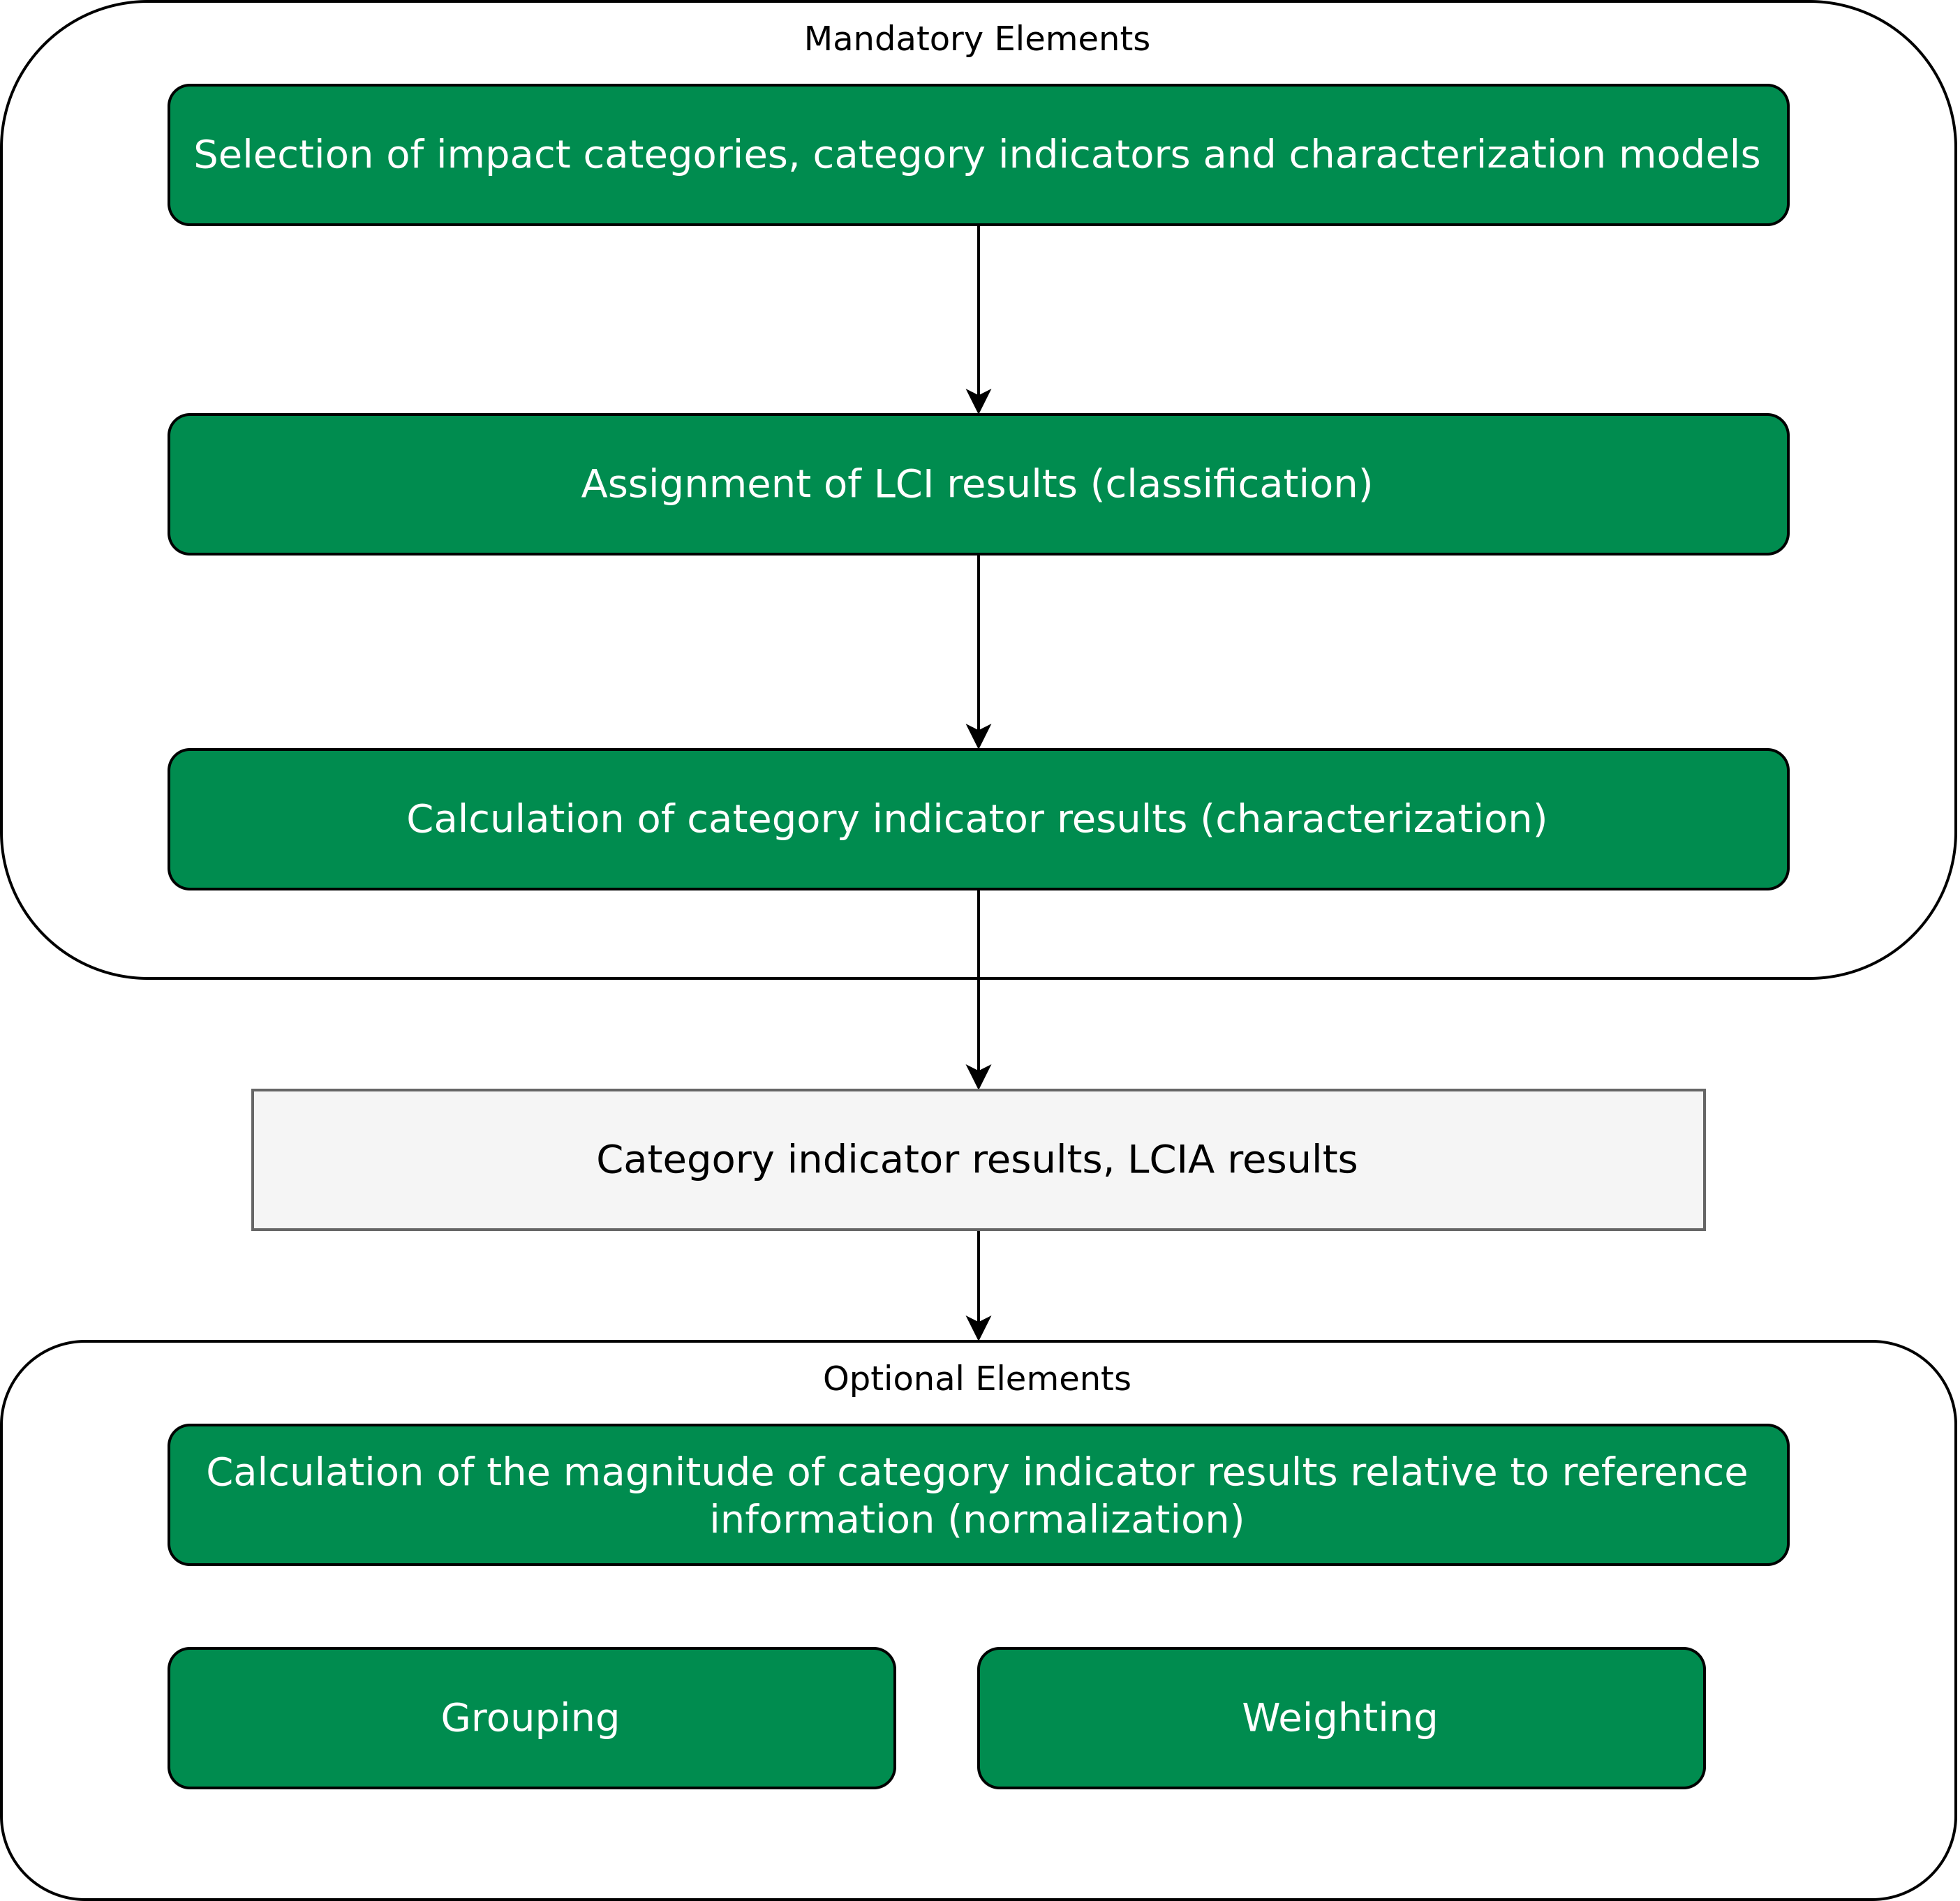
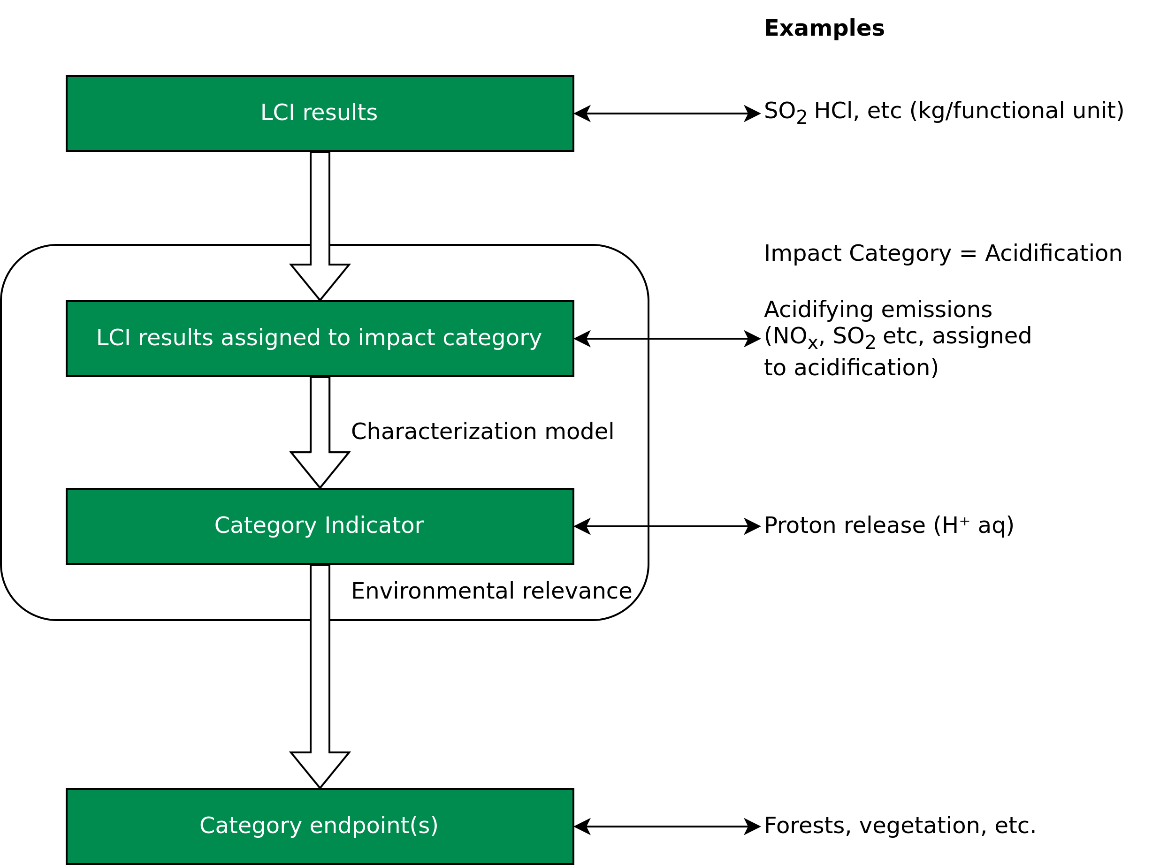
Lifecycle Impact Assessment (LCIA)
Elements of LCIA
Images recreated from :ISO 14040 Environmental management — Life cycle assessment — Principles and framework, International standards organisation (https://www.iso.org/standard/37456.html) and
Determining the environmental impacts of conventional and alternatively fuelled vehicles through LCA, Ricardo Energy and Environment (Link)

Slide 35
Lifecycle Impact Assessment (LCIA)
Elements of LCIA
Term | Example
Impact Category | Climate change
LCI results | Amount of a greenhouse gas per functional unit
Characterization model | Baseline model of 100 years of the Intergovernmental Panel on Climate Change
Category indicator | Infrared radiative forcing (W/m²)
Charecterization factor | Global warming potential (GWP100) for each greenhouse gas (kg CO2–equivalents/ kg of gas)
Category indicator result | Kilograms of CO2–equivalents per functional unit
Category endpoints | Coral reefs, forests, crops
Environmental relevance | Infrared radiative forcing is a proxy for potential effects on the climate, depending on the integrated atmospheric heat adsorption caused by emissions and the distribution over time of the heat adsorption.
ISO 14040 Environmental management — Life cycle assessment — Principles and framework, International standards organisation (https://www.iso.org/standard/37456.html)
Determining the environmental impacts of conventional and alternatively fuelled vehicles through LCA, Ricardo Energy and Environment (Link)

Slide 36
Lifecycle Impact Assessment (LCIA)
Example
Impact Category | Indicator and unit
Climate change | Greenhouse gas emissions GWP100 in CO2 eq (including carbon feedbacks)
Energy consumption | Cumulative energy demand in MJ: non-renewable (fossil and nuclear) and renewable
Acidification | Acidification potential in SO2 eq
Eutrophication | Eutrophication potential in PO4³⁻ eq
Photochemical ozone formation | Photochemical Ozone Creation Potential POCP in NMVOC eq
Ozone depletion | ODP in R11 eq
Ionising radiation | Ionising radiation potentials in U235 eq
Particulate matter | Particulate matter formation in PM2.5 eq
Human toxicity, cancer and non-cancer | Comparative Toxic Unit for Human Health in CTUh
Ecotoxicity, freshwater | Comparative Toxic Unit for ecosystems in CTUe
Resource depletion – minerals and metals | ADP ultimate reserves in Sb eq
Resource depletion – fossil energy carriers | ADP fossil in MJ
Land use | Land occupation in m² * a
Water scarcity | Scarcity-adjusted water use in m³
Pollutant | Acidification | Eutrophication | POCP | Particulate matter formation (PMF)
CO | 0 | 0 | 0.0456 | 0
NH3 | 1.6 | 0.35 | 0 | 0.64
NOx | 0.5 | 0.13 | 1 | 0.88
PM2.5 | 0 | 0 | 0 | 1
SOx | 1 | 0 | 0.0811 | 0.54
NMVOC | 0 | 0 | 1 | 0.012
Non-methane volatile organic compoind
Tables recreated from Determining the environmental impacts of conventional and alternatively fuelled vehicles through LCA, Ricardo Energy and Environment (Link)

Slide 37
Lifecycle Impact Assessment (LCIA)
Example
Chart adapted from Determining the environmental impacts of conventional and alternatively fuelled vehicles through LCA, Ricardo Energy and Environment (Link)

Slide 38
Lifecycle Interpretation
Definition
ISO 14040 definition
The phase of life cycle assessment in which the findings of either the inventory analysis or the impact assessment, or both, are evaluated in relation to the defined goal and scope in order to reach conclusions and recommendations.
ISO 14040 Environmental management — Life cycle assessment — Principles and framework, International standards organisation (https://www.iso.org/standard/37456.html)
Determining the environmental impacts of conventional and alternatively fuelled vehicles through LCA, Ricardo Energy and Environment (Link)

Slide 39
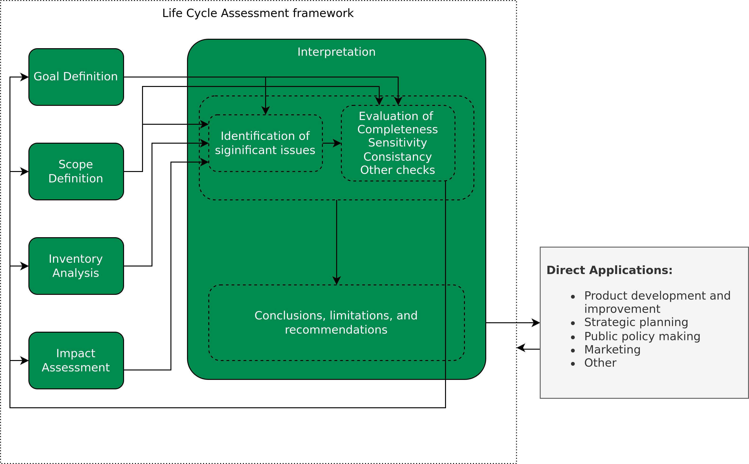
Lifecycle Interpretation
Identification of significant issues
Two interrelated aspects of significant issues:
The main contributors to environmental impacts, like most important lifecycle stages, processes and elementary flows.
The main choices that have the potential to influence the precision of the final results of the LCA, like methodological choices (e.g., cut-offs), assumptions, data, LCIA methods.
Image adapted from ISO 14040 Environmental management — Life cycle assessment — Principles and framework, International standards organisation (https://www.iso.org/standard/37456.html)
Determining the environmental impacts of conventional and alternatively fuelled vehicles through LCA, Ricardo Energy and Environment (Link)

Slide 40
Lifecycle Interpretation
Evaluation
Evaluation is performed to establish the foundation for subsequently drawing the conclusions and provide reccommendations during the interpretation of the study results.
This involves:
Completeness checks
Sensitivity checks in combination with scenario analysis and potentially uncertainity analysis
Consistancy checks
ILCD Handbook – General guide for Life Cycle Assessment – Detailed Guidance (Link)

Slide 41
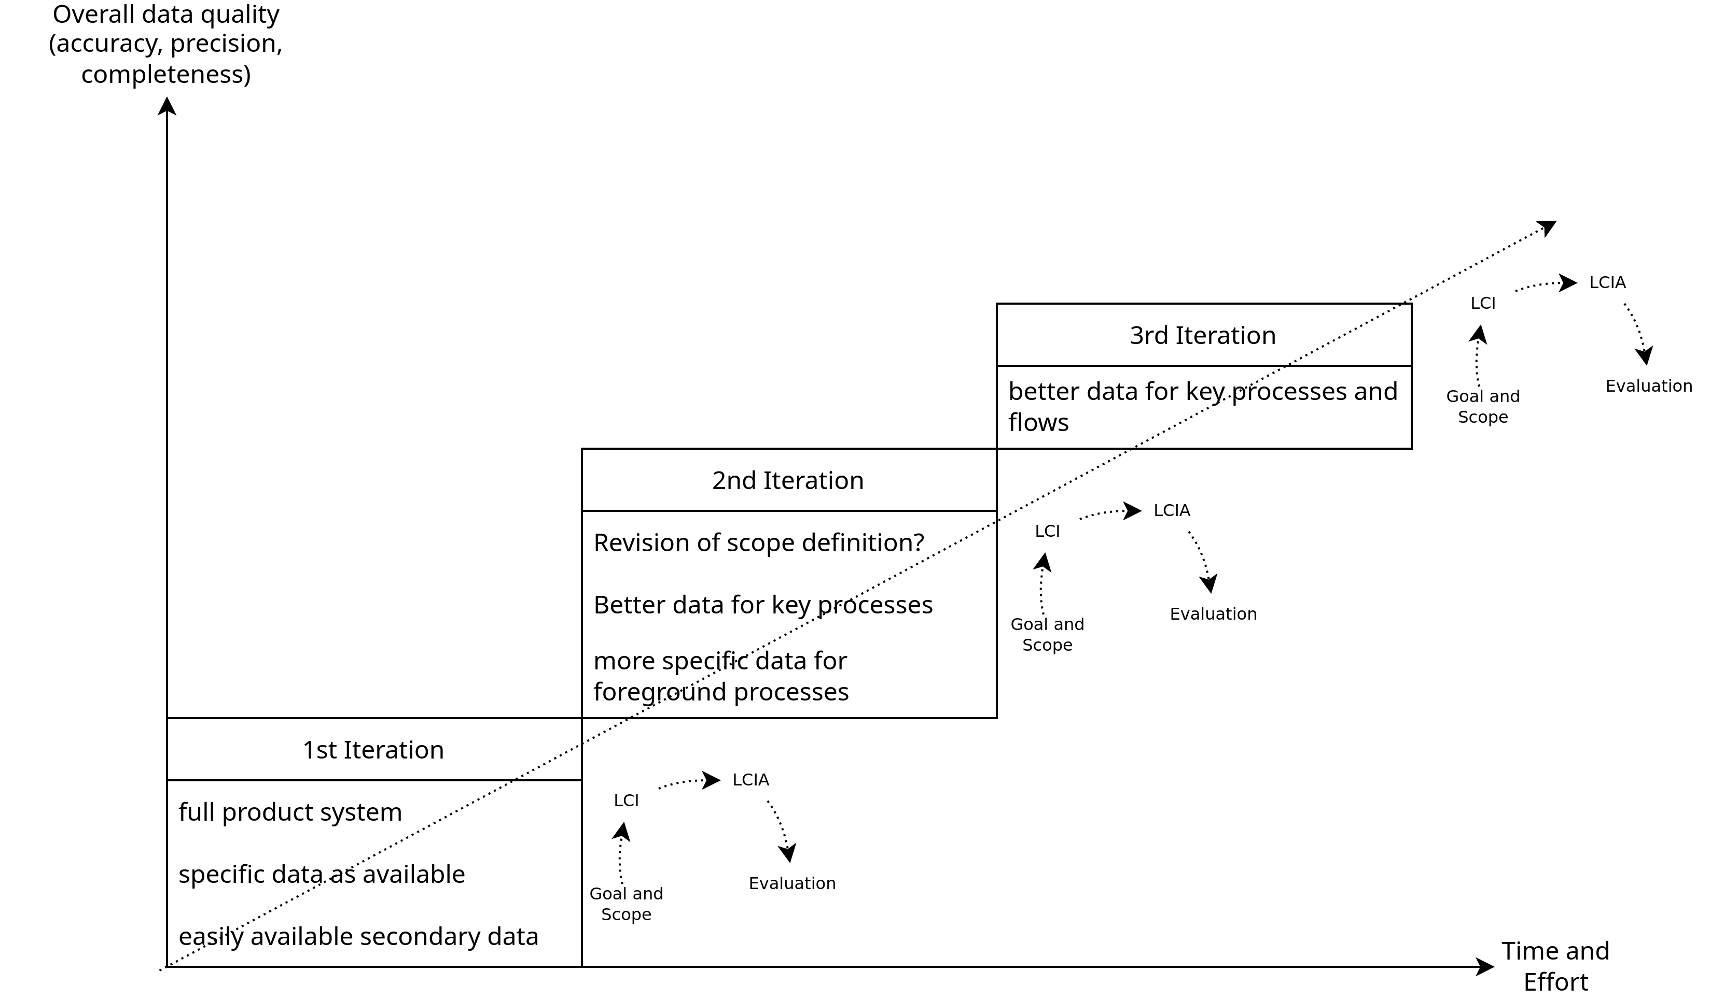
Iterative approach to LCA
ILCD Handbook – General guide for Life Cycle Assessment – Detailed Guidance (Link)

Slide 42
Reporting and Critical review
A reporting strategy is an integral part of an LCA.
A report should:
contain the results and conclusions of the LCA in an adequate form to the intended audience
address the data, methods and assumptions applied in the study, and the limitations thereof.
ISO 14040 Environmental management — Life cycle assessment — Principles and framework, International standards organisation (https://www.iso.org/standard/37456.html)

Slide 43
Reporting and Critical review
A reporting strategy is an integral part of an LCA.
A report should:
contain the results and conclusions of the LCA in an adequate form to the intended audience
address the data, methods and assumptions applied in the study, and the limitations thereof.
A critical review will fascilitate understanding and enhance the credibility of the LCA.
Critical reviews verify whether the LCA has met the requirements for methodology, data, interpretation and reporting and whether it is consistant with it’s principles.
Carried out by an internal or external expert, or by a panel of interested parties.
ISO 14040 Environmental management — Life cycle assessment — Principles and framework, International standards organisation (https://www.iso.org/standard/37456.html)

Slide 44
Conclusion

Slide 45
Conclusion
A high-level overview and guide to Life Cycle Assessment
Goal and Scope definition
Life Cycle Inventory analysis
Unit Processes and Process flows
Life Cycle Impact Assessment
Impact categories, classification, characterization, weighting, etc.
Life Cycle Interpretation
Evaluation
Reporting and Critical review
Examples from Polestar and the 2020 EU Commission report.

Slide 46
Exercise E04

Slide 47
Exercise E04
My Favorite Fruit/Vegetable – LCA using OpenLCA
With the fruit/vegetable you chose in E03, and the information you gathered, compute the Environmental Impact of the product system, including:
Production of the fruit/vegetable
Transport of the fruit/vegetable to the place you bought it from
..
You can use the automated tools provided in OpenLCA to do this easily, using the free datasets provided on OpenLCA Nexus.
Suggested detailed tutorial: https://www.youtube.com/watch?v=kEosW6PceVg
QnA session tutorial will also be available via Github.
Default option → potato
Use an existing LCIA methodology, such as BEES+.
Submit your submission according to the instructions in the exercise sheet.

Slide 48
Questions?

